Slide 1
ROS培训 I
CMakeLists.txt
与package.xml
SRT2021

Slide 2
Cmakelists.txt 结构
1. Required CMake Version
2. Package Name
3. Find other CMake/Catkin packages needed for build
4. Enable Python module support
5. Message/Service/Action Generators
6. Invoke message/service/action generation
7. Specify package build info export
8. Libraries/Executables to build

Slide 3
CMake Version
Specifies the required version of CMake.
Catkin requires version 2.8.3 or higher.
Every CMakeLists.txt must start with this call.

Slide 4

Package name
Specifies the name of the package
You can reference the project name anywhere
later in the CMake script by using the variable
${PROJECT_NAME} wherever needed.

Slide 5
Finding Dependent CMake Packages
Specifies which other CMake packages
that need to be found to build our project.
There is always at least one dependen-
cy on catkin: catkin REQUIRED

Slide 6
Finding Dependent CMake Packages
Example

Slide 7
Message, service, action
The three types of files require a
special preprocessor build step:
add_message_files()
add_service_files()
add_action_files()

Slide 8

Message, service, action
e. g.

Slide 9

Message, service, action
After former macros called, the following
macro should be called.

Slide 10

Message, service, action
generate_message() generate added messages and services with any dependencies listed here.
e.g.
All macros mentioned in this part must be
called BEFORE catkin_package().

Slide 11
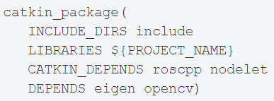
catkin_package
Specify catkin-specific information to the build system which in turn is used to generate pkg-config and CMake files.

Slide 12
catkin_package
5 optional arguments details:
INCLUDE_DIRS – exported include paths for the package
LIBRARIES – exported libraries from the project
CATKIN_DEPENDS – other catkin projects that this
project depends
DEPENDS – non-catkin CMake projects that the project
depends on
CFG_EXTRAS – additional configuration options

Slide 13
catkin_package
This function must be called BEFORE declaring
any targets with add_library() or add_executable()

Slide 14

Build targets specification
Prior to specifying targets, one should specify direc-
tories containing targets.

Slide 15
Build targets specification
include_directories() format e.g.
link_directories() is not recommended, however.

Slide 16
Build targets specification
Use add_executable to specify executable target.
Use add_library to specify libraries to build.

Slide 17
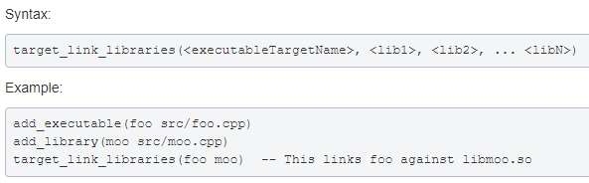
Build targets specification
Use target_link_libraries to specify which libraries an
executable target links against. Typically after an
add_executable all.

Slide 18
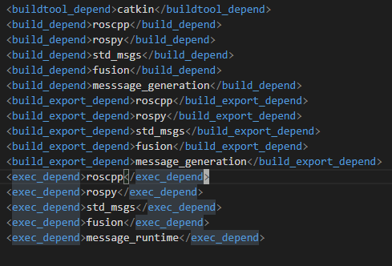
Package.xml结构
Mainly we modify package.xml when adding msg/srv
files and so on.
e. g.

Slide 19
实操——跨包调用
创建新的catkin工作空间
mkdir -p catkin_ws/src && cd catkin_ws
catkin_make
创建一个包 （包名随意）
catkin_create_pkg test roscpp
创建msg文件与src文件
cd src/test
mkdir msg && mkdir src

Slide 20
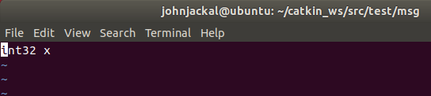
cd src && touch test.cpp && cd ..
cd msg && touch test.msg
编辑msg文件，填充你想要的信息格式
e. g.
我们不打算在test包中写任何可执行文件，故下一步
直接编辑CMakeLists.txt与package.xml

Slide 21
编辑CMakeLists:
在find_package()括号内添加message_generation
在catkin_package()前添加如下语句：
add_messages(
FILES
test.msg #你在此包中创建的msg文件名
)
在catkin_package()中将DEPENDS一行前面注释符删去，
并在该行末加上 message_runtime

Slide 22
之后编辑package.xml
加入<build_depend>message_generation</build_depend>
与<exec_depend>message_runtime</exec_depend>
即可
至此，test包编写完成。
下面创建另一个包，调用test包中的msg进行
通信

Slide 23
创建第二个包（包名随意）
cd ~/catkin_ws/src
catkin_create_pkg msg_using test roscpp
编写talker.cpp和listener.cpp（可按之前你们看过的ros
教程给的例程来写）
p. s. 在这些cpp中include消息头文件时，按test包索引，
按之前编写的例子即： #include “test/test.h”
之后编译源码

Slide 24
p. s. 建议不要使用catkin_make编译，推荐使用
catkin_build，这是基于python的编译工具。如果
显示没有此命令，则使用apt-get 安装python-catkin-tools
sudo apt-get install python-catkin-tools
之后执行这两个脚本(如果之前学会了roslaunch可以
自己写一个launch文件)

Slide 25
